Slide 1
Pre-training for pathology images
Parsa Sharifi

Slide 2
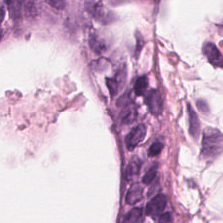
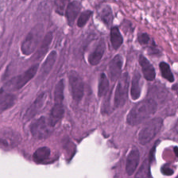
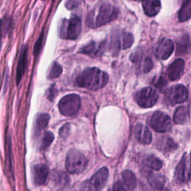
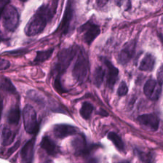
BRACS dataset
complicated
7 classes

Slide 3
Resnet34
classification task
acc | wga | bga | epoch | total epoch
0.77 | 0.67 | 0.91 | 16 | 50

Slide 4
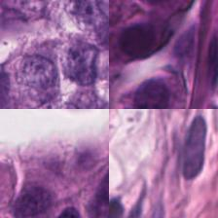
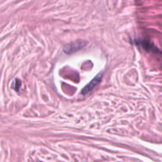
Multi-task pretrain
2 tasks(10 and 4 classes)

Slide 5
Task 1
Guess the magnification
x1, x1.2, x1.4, x1.6
2500 each class

Slide 6
Task 2
Jigsaw puzzle
Created based on Magnification
6000 for each class

Slide 7
Results!!
10 epoch for pre-training
Using short amount of data
Improving total accuracy and …
acc | wga | bga | epoch | total epoch
0.79 | 0.71 | 0.91 | 16 | 50

Slide 8
Using other datasets
Using other configs
Using the dataset itself for tasks
acc | wga | bga | epoch | total epoch
0.58 | 0.32 | 0.85 | 46-50 | 50

